Slide 1

Languru App
SPRING 2023 - CS 691- CAPSTONE PROJECT
PROFESSOR HENRY WONG
PACE UNIVERSITY

Slide 2
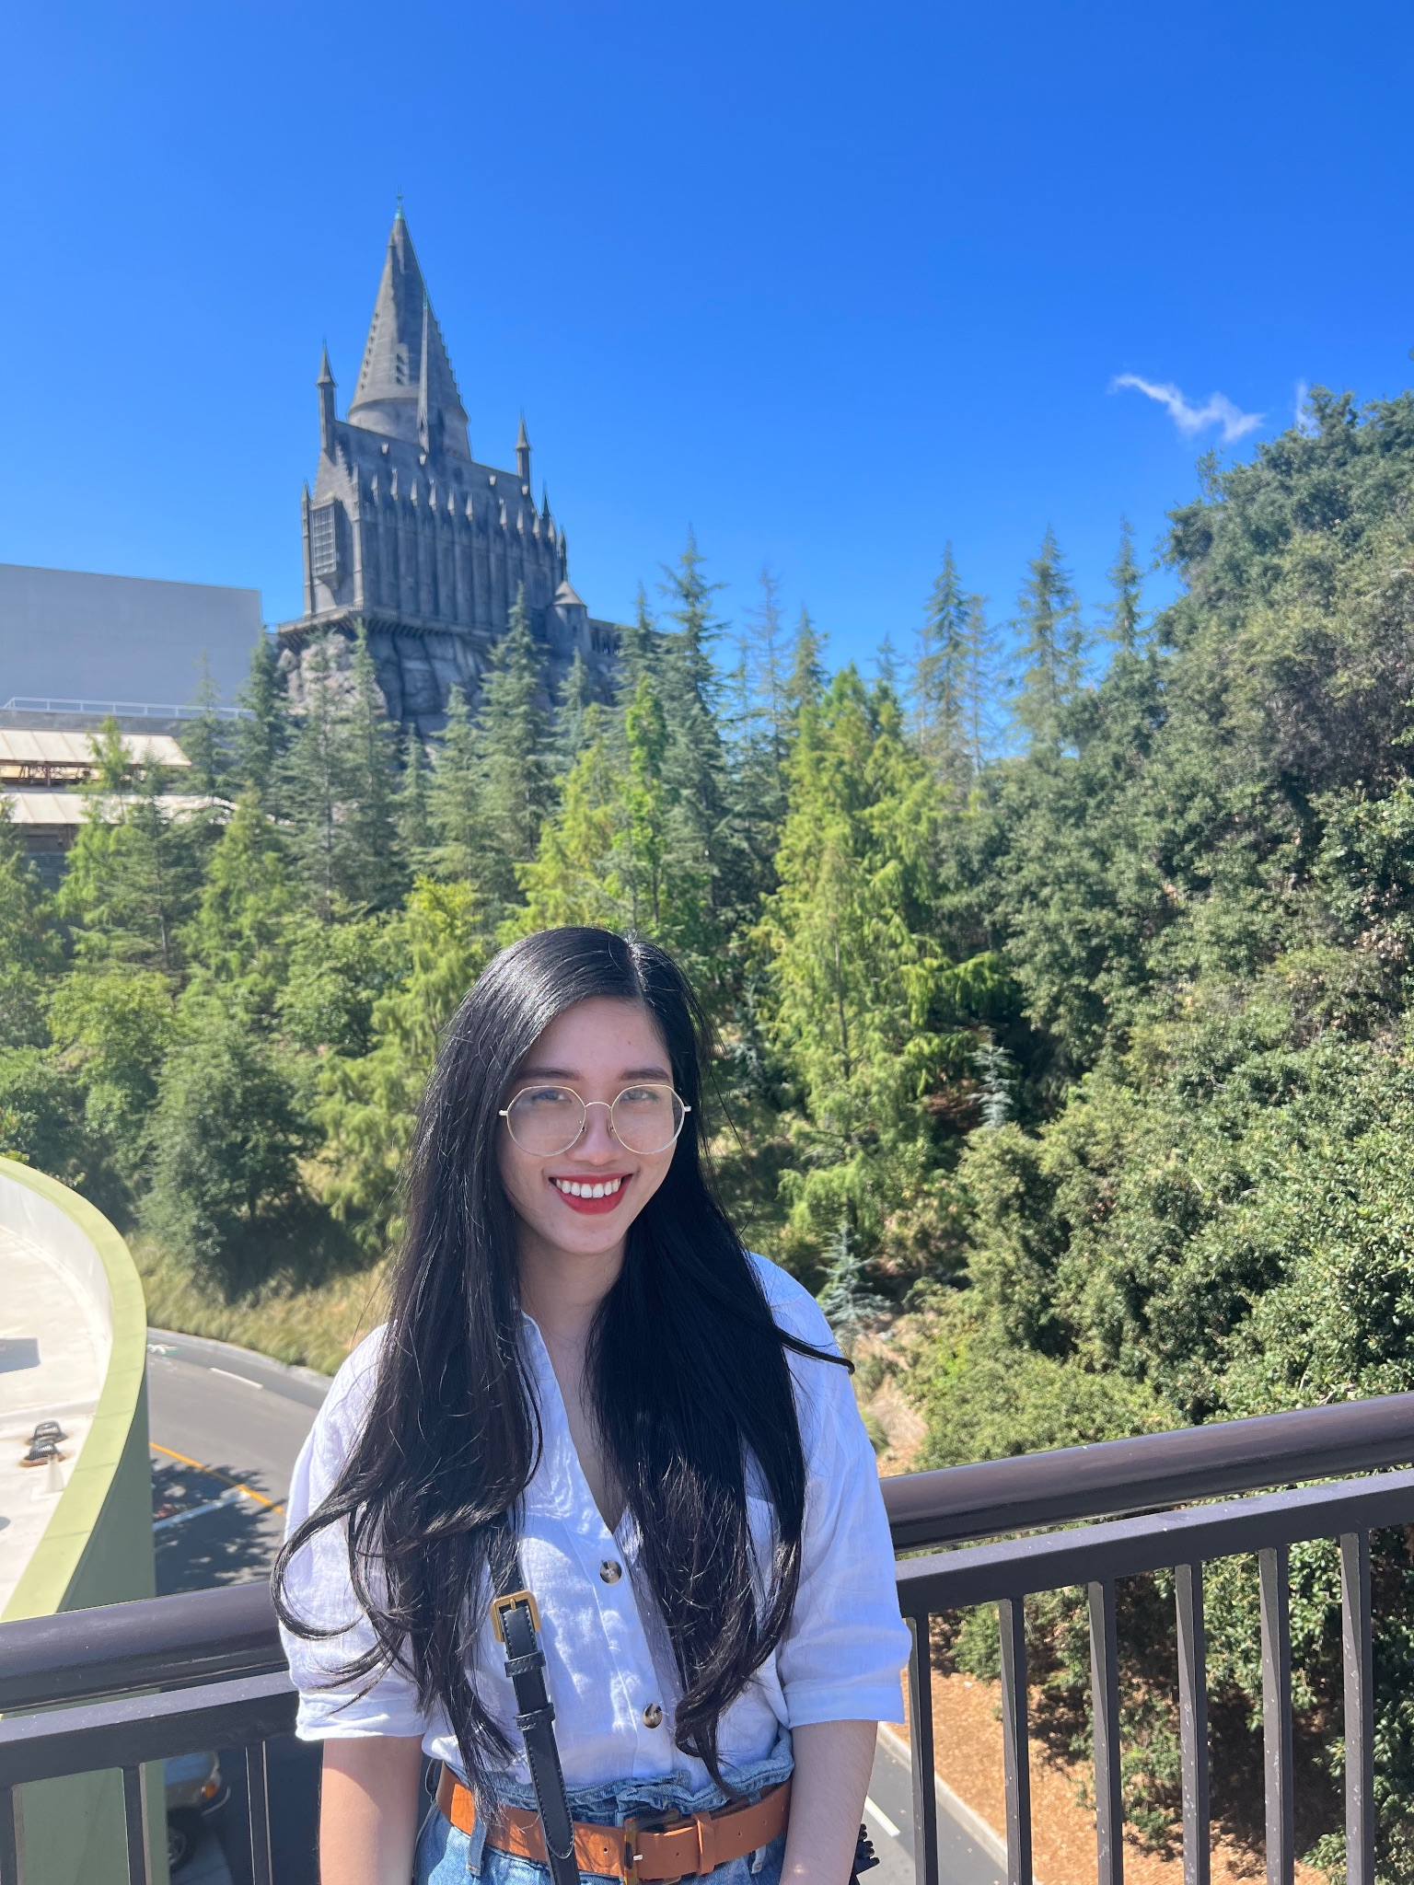
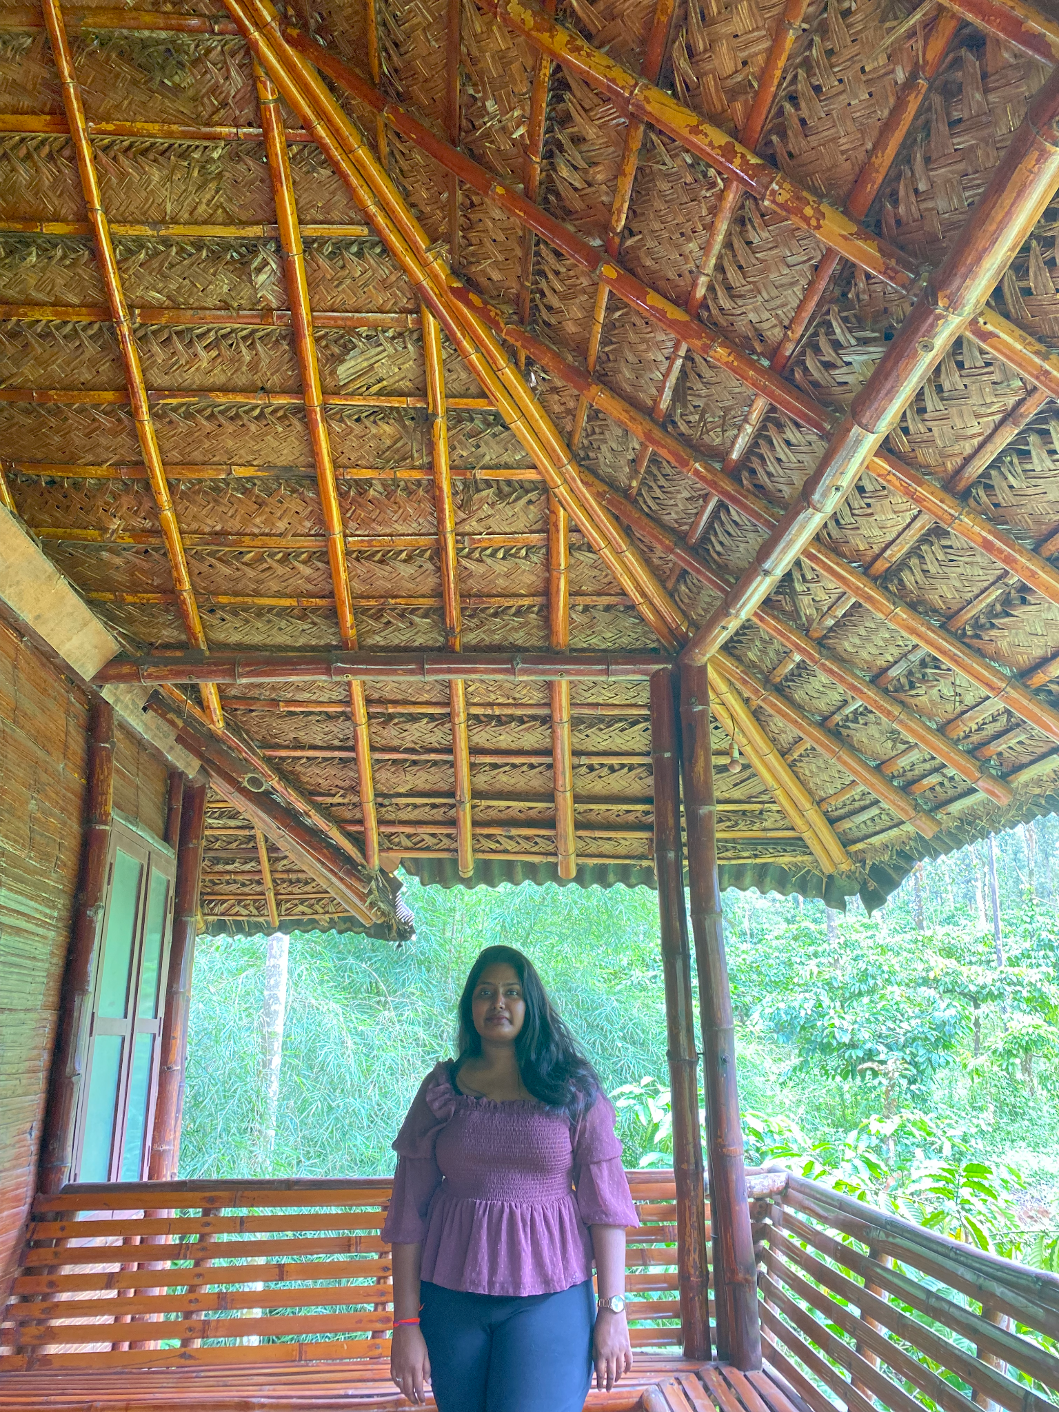
Our team
Thanh (Kate) Pham
Indeevara Tadikonda
Software Developer,
Scrum Master
Developer

Slide 3



Our Team
Hariharammurthy Krishnamoorthy
Musa Nishat
Noel Sam Routhu
Quality Analyst And Tester
Developer
Database Administrator

Slide 4
Agenda
01
07
02
08
03
09
04
10
05
11
06
12
Improvement from Professor’s Feedback
Sprints Recap
Problem Statement vs Solution
Product Backlog and Sprint Backlog
Personas
Metrics
Minimum Viable Product
Retrospective
Technologies
Sprint 5
Architecture Diagrams
Live Application Demo

Slide 5
01
IMPROVEMENT from
PROFESSOR’S FEEDBACK

Slide 6
Improvement from Professor’s Feedback
Feedback
Late submission
Specifying AWS service
Missing Acceptance Criteria slides
→The team submitted all work on time.
→ The team explained what kind of AWS services used for databases
→ The team added Acceptance Criteria slides.

Slide 7
02
PROBLEM vs SOLUTION

Slide 8
Problem Statement
-English learners faces challenges when they speak E.L correctly due to limited feedback on their speech while English teachers’ feedback is costly and time consuming.
-The current speech recognition technology is not accurate enough to provide reliable feedback on pronunciation, which can hinder the learning process.

Slide 9
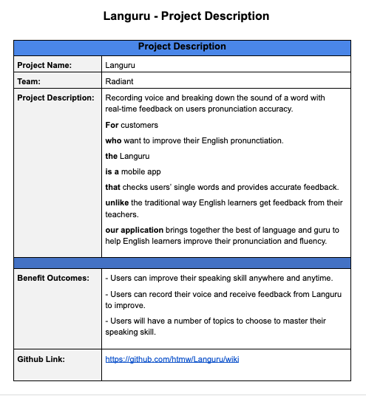
Project Description

Slide 10
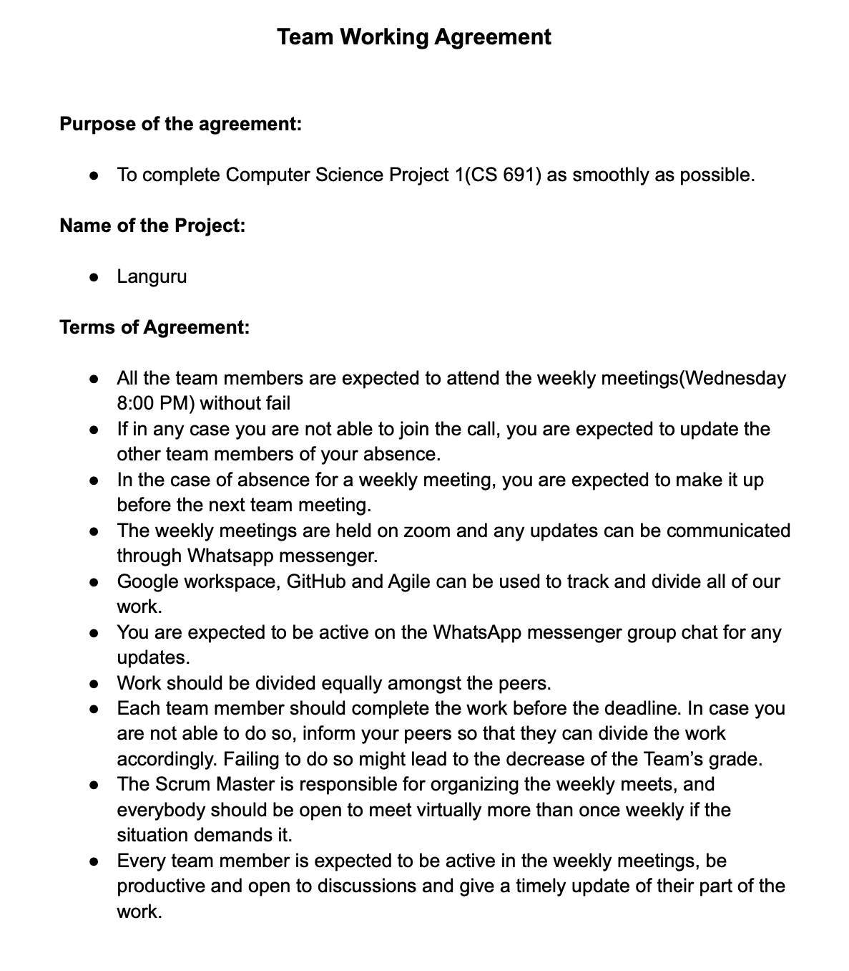
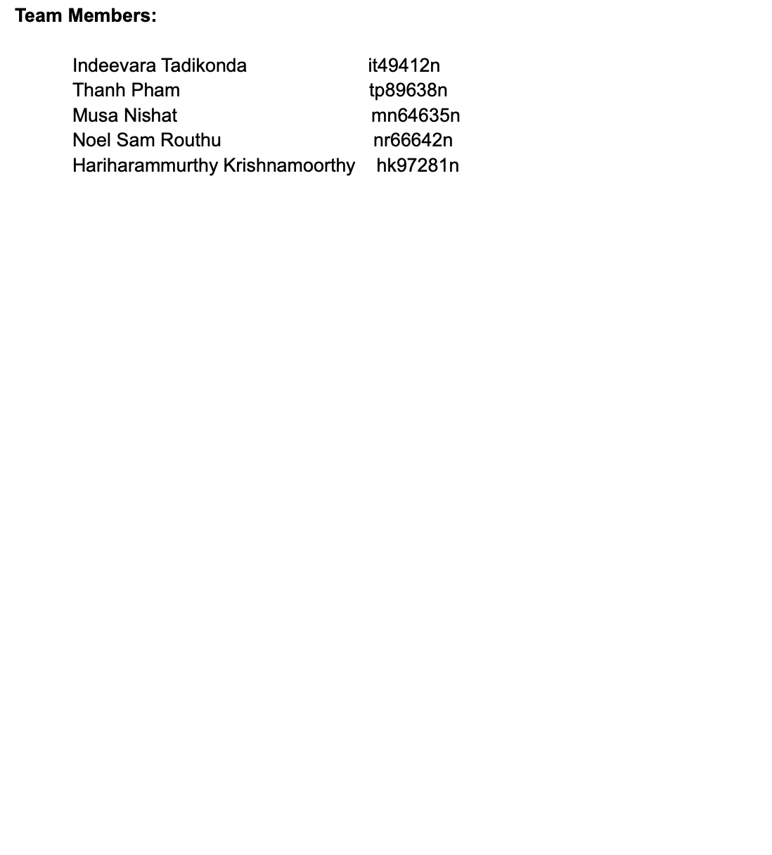
Team Working Agreement

Slide 11
03
PERSONAS

Slide 12
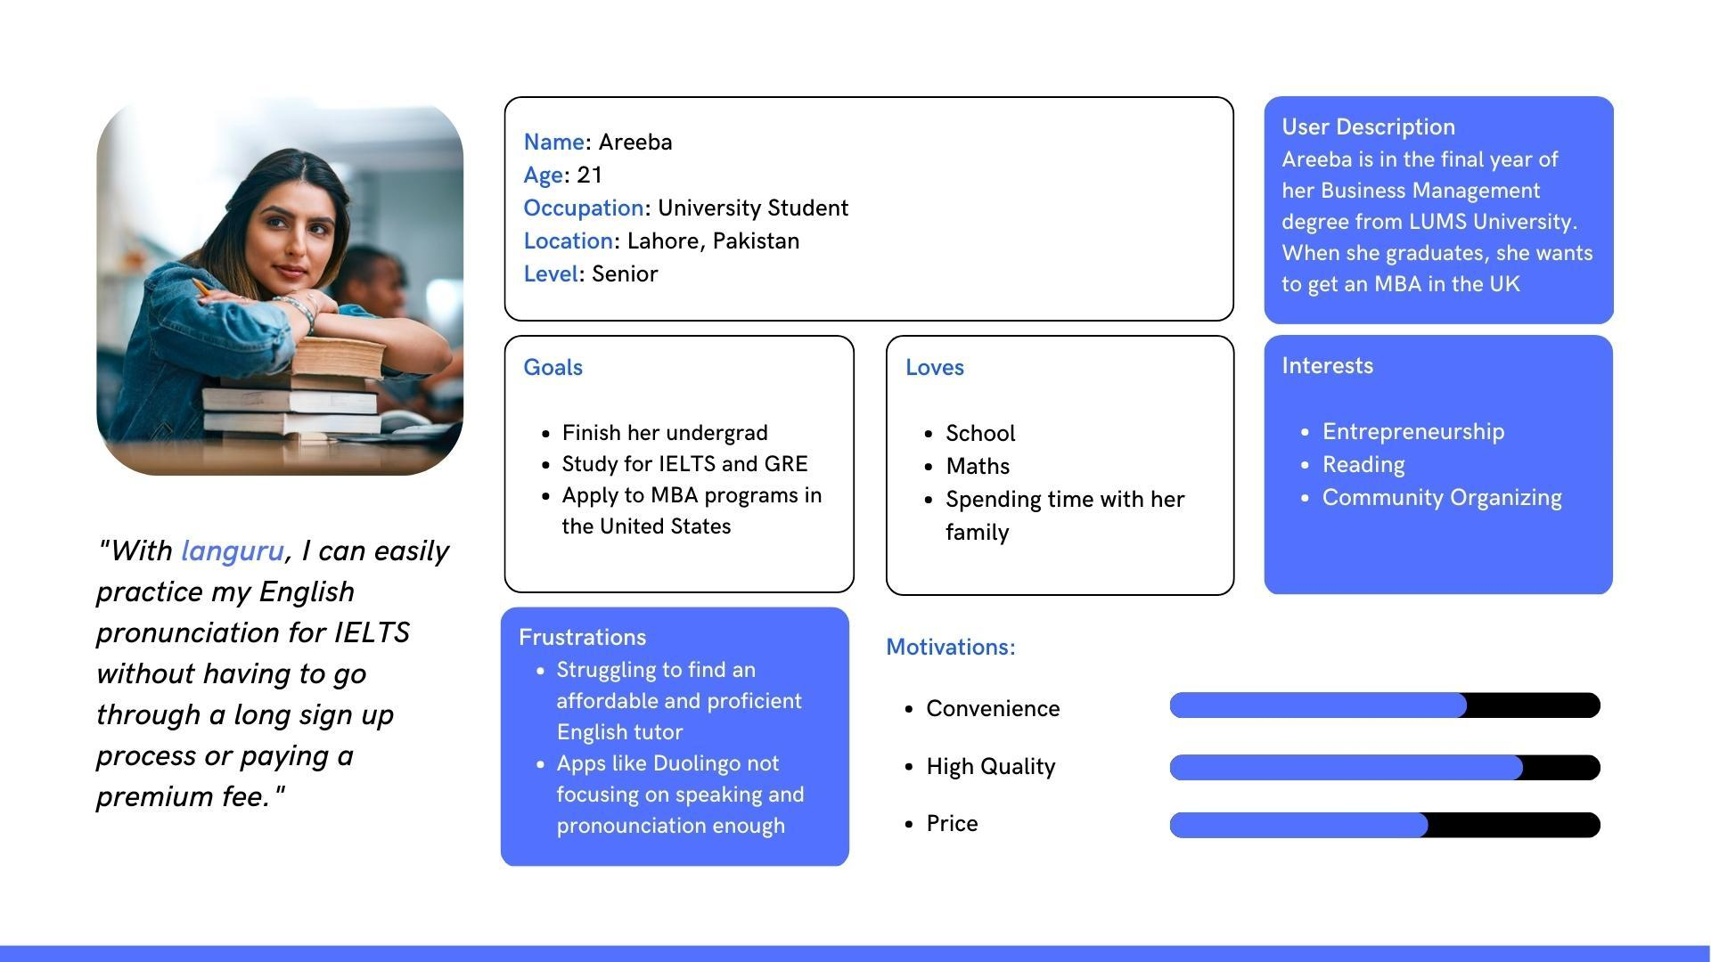
PERSONA 1

Slide 13
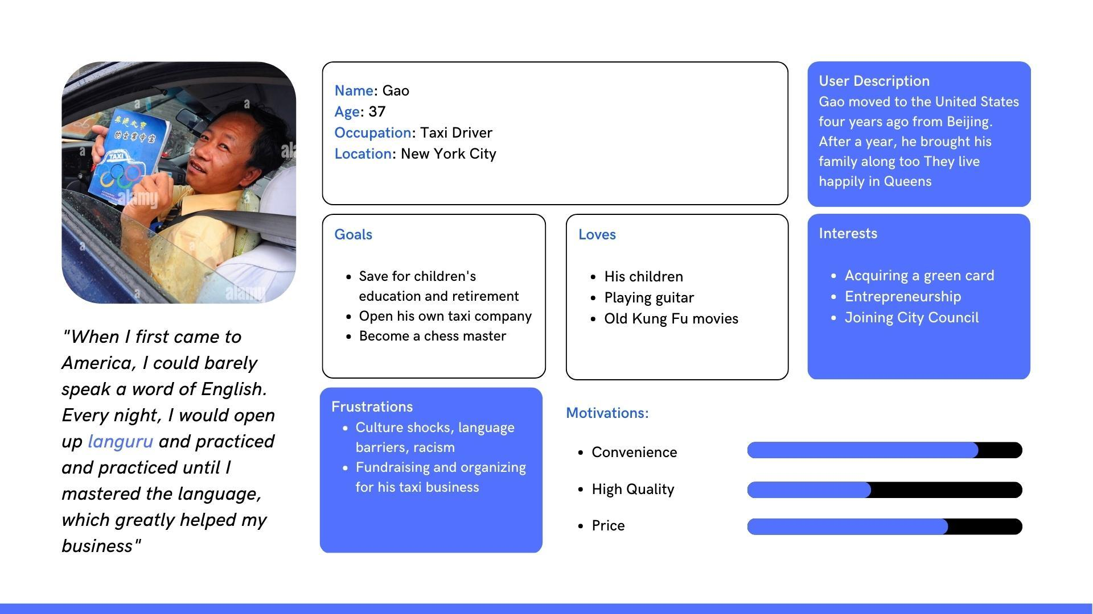
PERSONA 2

Slide 14
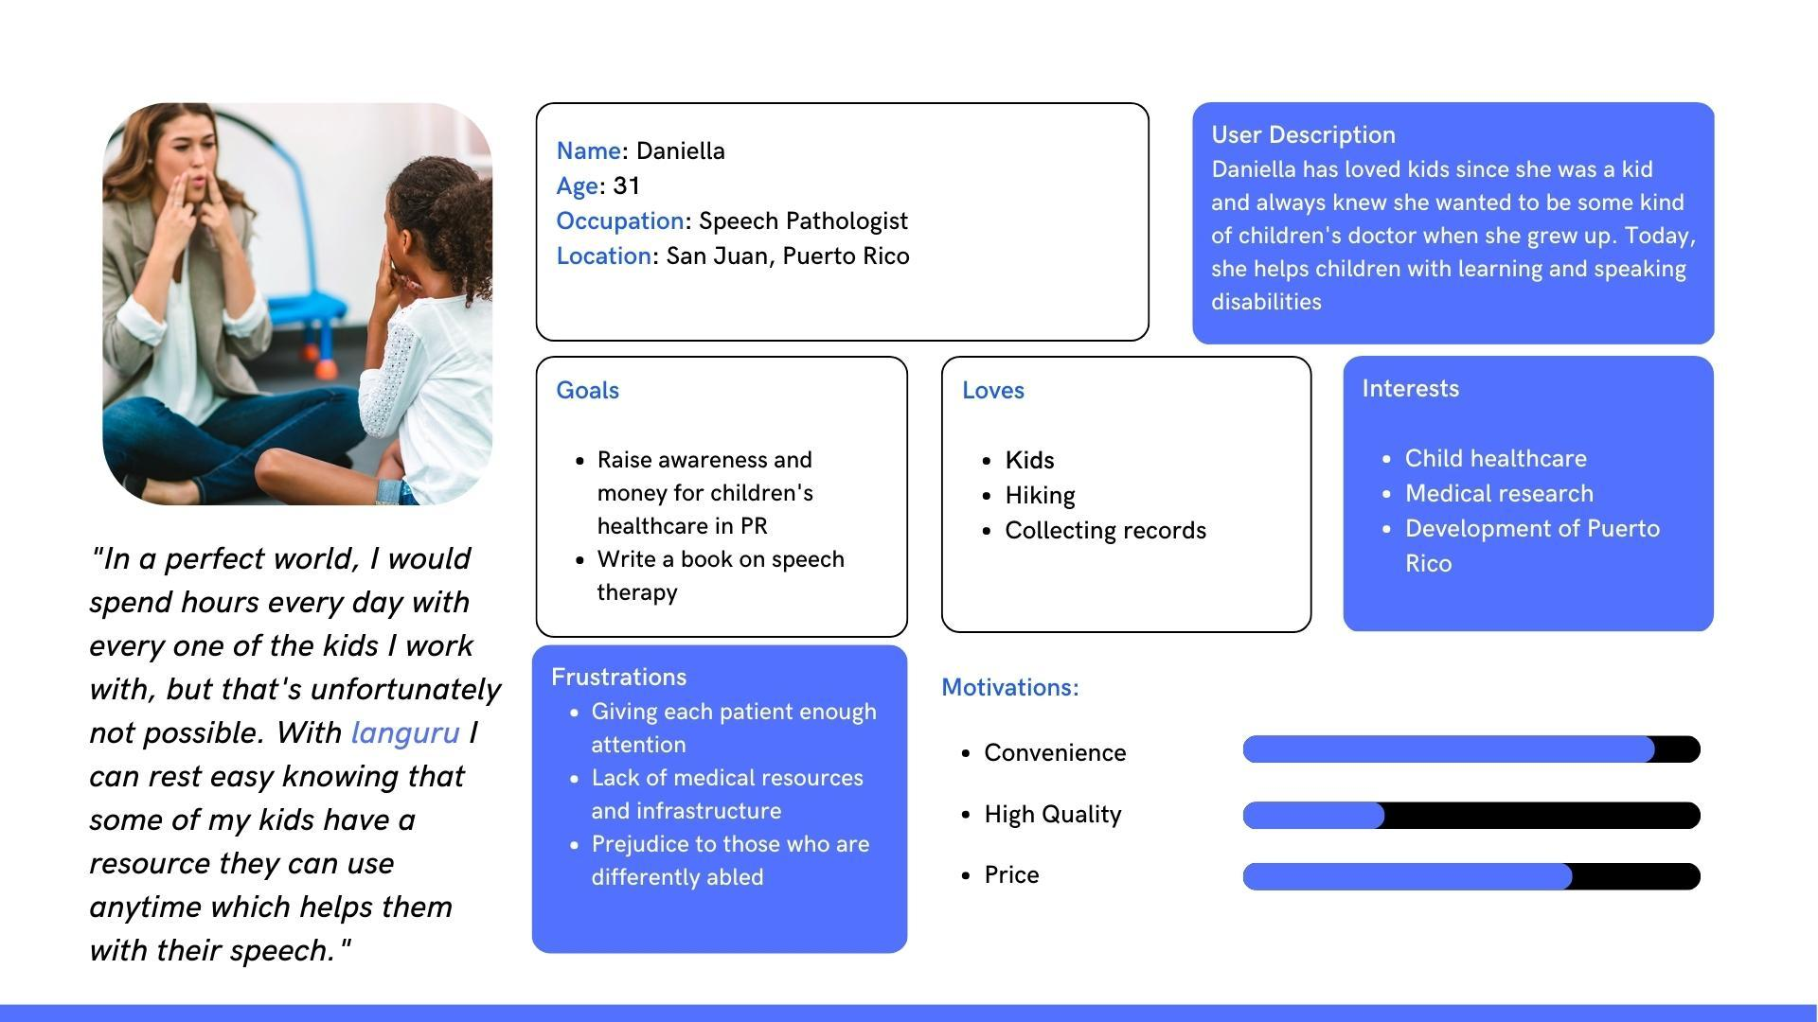
PERSONA 3

Slide 15
04
MINIMUM VIABLE PRODUCT

Slide 16
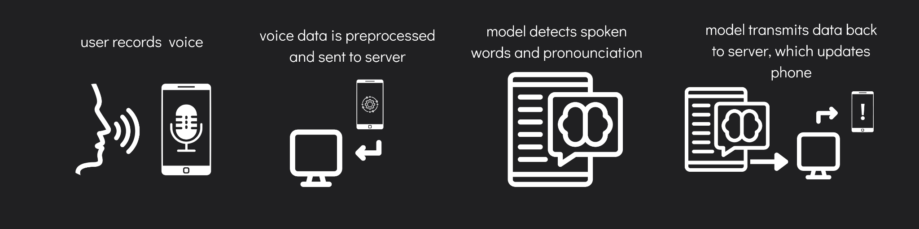
MINIMAL VIABLE PRODUCT (MVP)
Mobile application with speech recording capability
Machine learning algorithm/API to break down individual spoken words, detect, and note incorrect pronunciations
Server with functionality to receive voice data and send back analyzed data
Server to host machine learning model
Steps:

Slide 17
APP LOGO
The name of the app is a combination of Language and guru. Blue will be the main theme of the application.

Slide 18
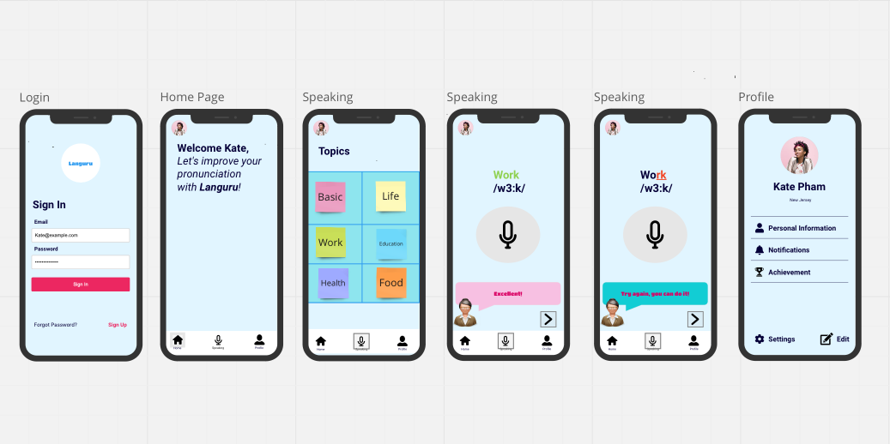
MOCK UP DESIGN

Slide 19
05
TECHNOLOGIES

Slide 20
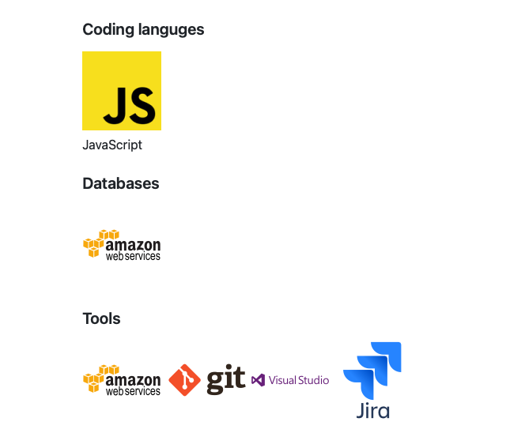

Slide 21
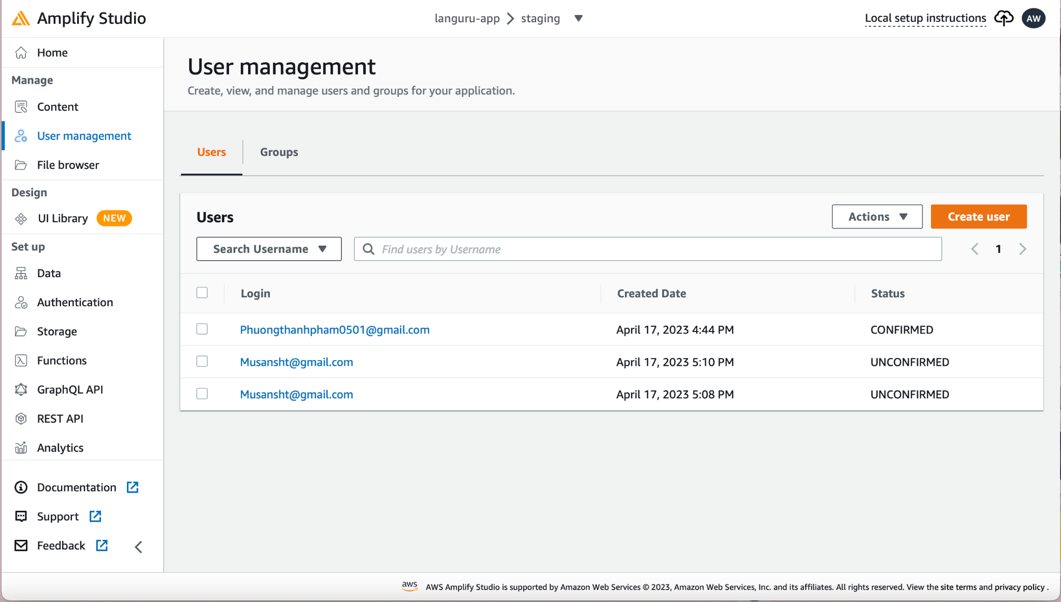
AWS Amplify Studio was used to manage authenticated users, authentication flow.

Slide 22
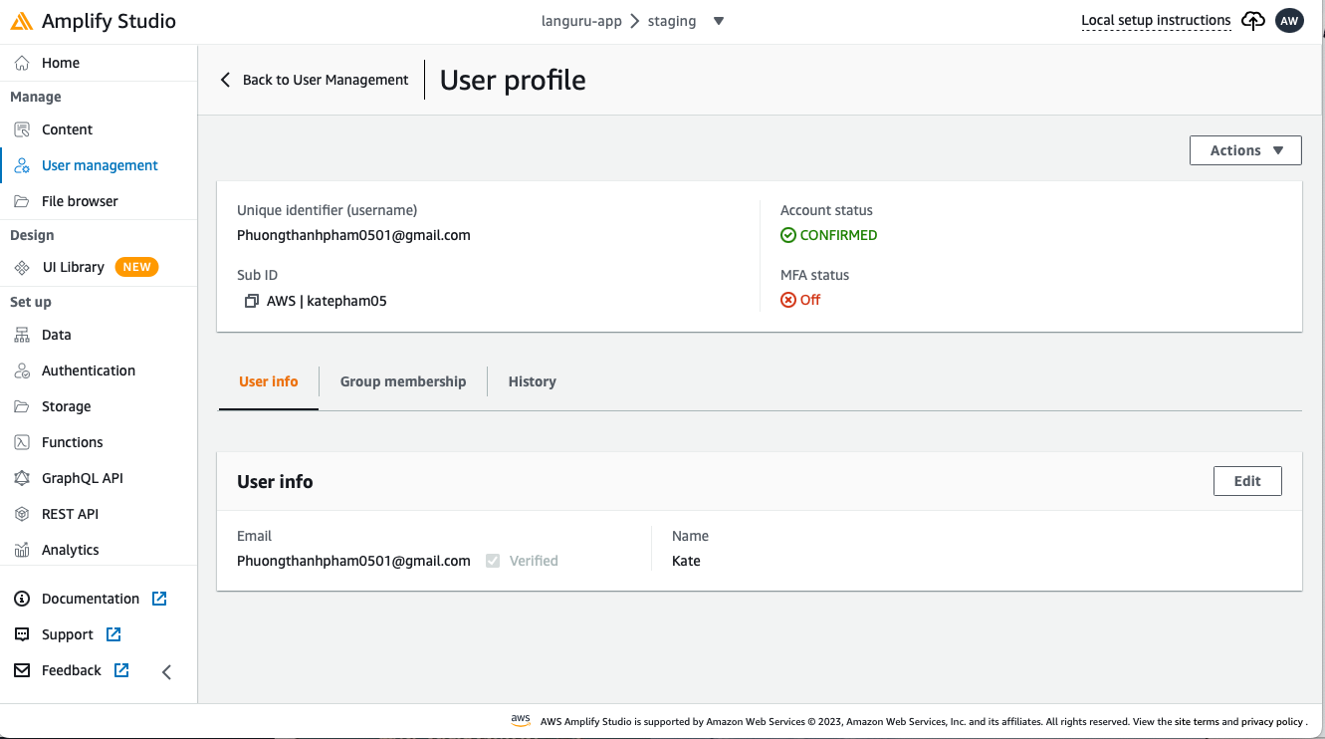
AWS Amplify Studio was used to manage user’s data

Slide 23
06
ARCHITECTURE DESIGN

Slide 24
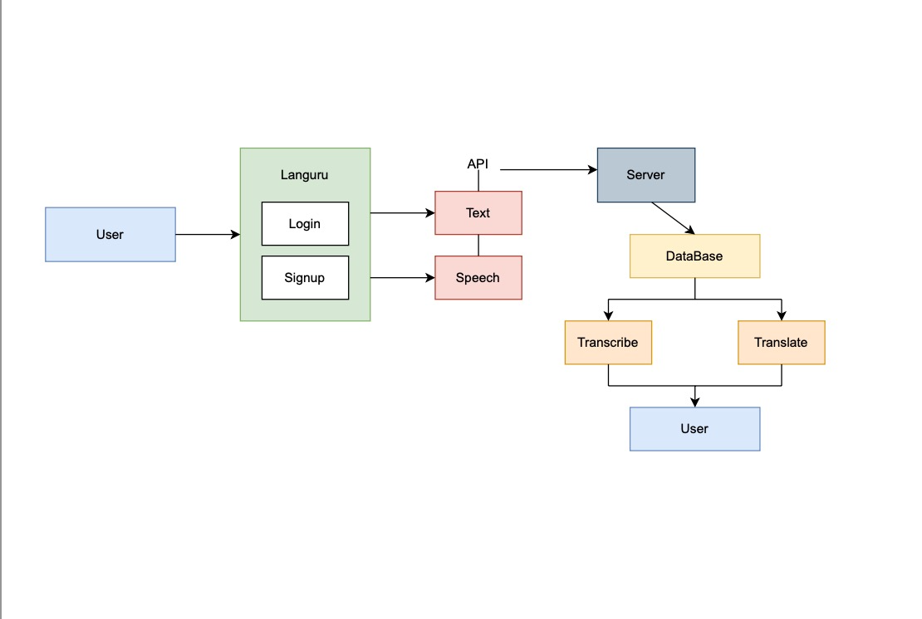
System Diagram

Slide 25
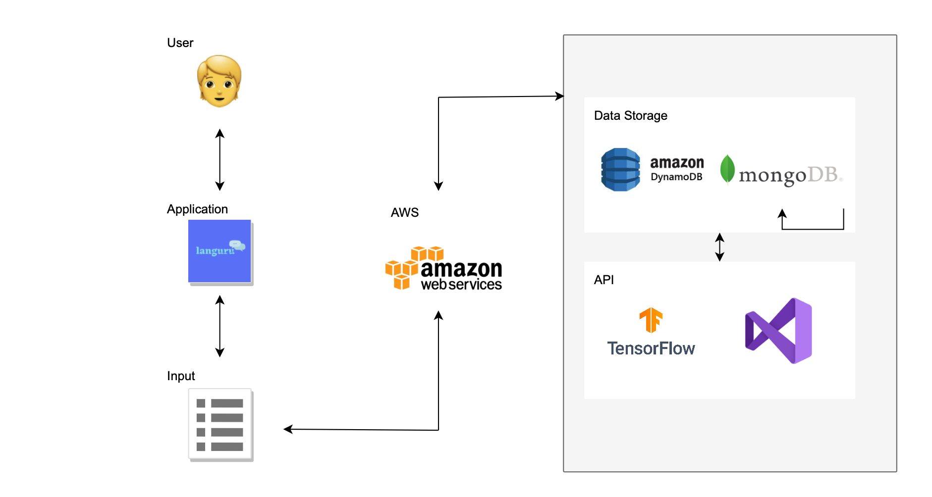
Conceptual Architecture Diagram

Slide 26
SEQUENCE DIAGRAM
User
Languru
Speech Recognition
Record Audio
Process Audio data
Analyze Speech Data
Return Feedback
Review Feedback

Slide 27
07
SPRINTS RECAP

Slide 28
SPRINT 3 VS SPRINT 4
SPRINT 3
SPRINT 4
LOGIN PAGE
SIGN UP
HOME PAGE
RECORD PAGE WITH SCORE FUNCTION
PROFILE PAGE BASIC
SETTING PAGE BASIC
User can see which part of the word was pronounced correctly and incorrectly
Add more words for user to practice with.
User can manage their information.

Slide 29
SPRINTS RECAP
SPRINT 1
SPRINT 2
SPRINT 3
Brainstorming Project Ideas
FInalizing Project Idea
Awaiting Approval
Setting up JIRA & GitHub
Assign Team Roles
Finalizing Team Working Agreement
Finalizing Technologies
Creating a Mock Up Design of the application
Came up with Sequence and Architectural illustrations
Designed User Stories & Test Cases
Developed basic functionalities of recording and playing back in the application
Introduced more user stories for profile page
Developed Login, SignUp and Home screens
Developed the functionalities of scoring for recording.
Developed Profile page and Settings page basic features

Slide 30
SPRINTS RECAP
SPRINT 1 SUMMARY
Started with project ‘Languru’ to help personnel improve their English skills.
Decided on Technologies, assigned team member roles.
Received approval from the Project Manager to go ahead with the development of the idea.
Finalized the Team Working agreement.
Set up JIRA and GitHub tools.

Slide 31
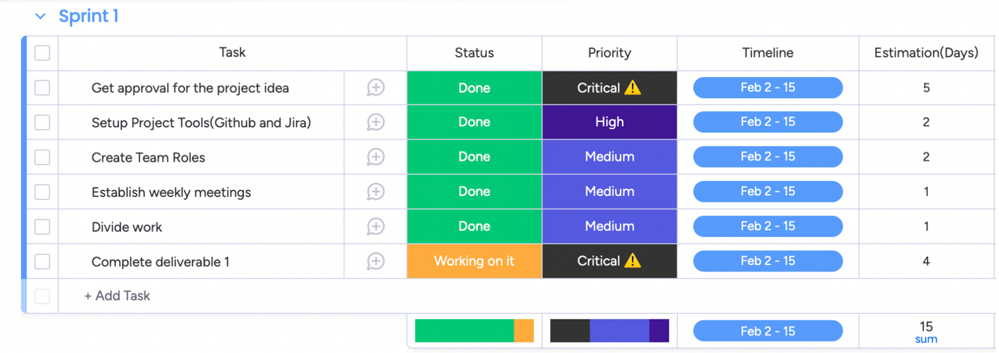
SPRINTS RECAP
SPRINT 1 PRODUCT BACKLOG

Slide 32
SPRINTS RECAP
SPRINT 2 SUMMARY
Illustrated Minimum Viable Product (MVP) of the application.
Designed the Mock Up of the application.
Designed User Stories and Acceptance Criteria.
Created Test Cases and performed Unit Testing on the application.
Recorded a small demo of the working of the application, including basic functionality such as Recording.

Slide 33
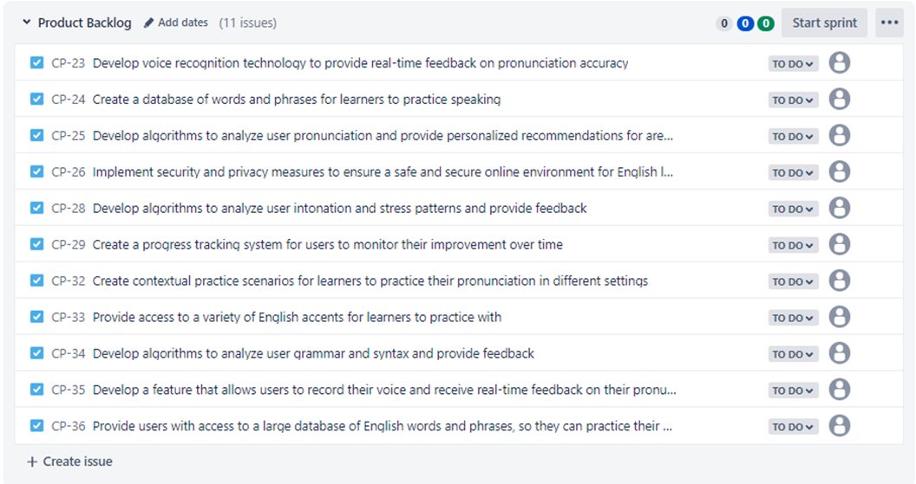
SPRINTS RECAP
SPRINT 2 PRODUCT BACKLOG

Slide 34
SPRINTS RECAP
SPRINT 3 SUMMARY
Developed Login, SignUp, Home and Settings screens
Designed User Stories and Acceptance Criteria.
Created Test Cases and performed Unit Testing on the application.
Captured and presented basic screenshots of the working of the application.
Developed functionalities such as Recording, Playback, Scoring etc.,

Slide 35
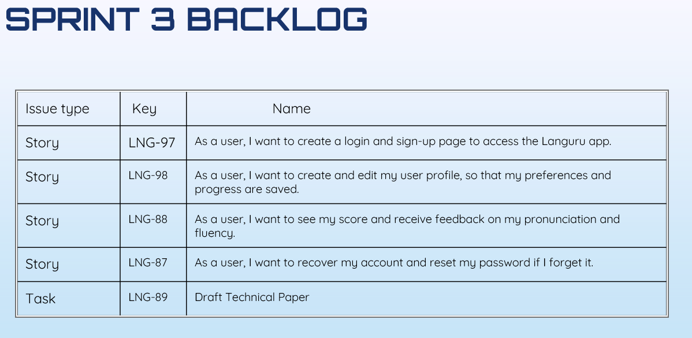
SPRINTS RECAP
SPRINT 3 PRODUCT BACKLOG

Slide 36
08
PRODUCT BACKLOG
AND
SPRINT BACKLOG

Slide 37
PRODUCT BACKLOG
Story | LNG-102 | As a user, I want to keep track of my progress in pronunciation and fluency So that I can see my improvement over time.
Story | LNG-103 | As a user, I want large database choice of words and phrases to practice my speaking
Story | LNG-104 | As a user, I need access to variety of english accents to practice with
Story | LNG-105 | As a user, i want a feedback to analyze my stress and intonation patterns
Story | LNG-106 | As a user, I want to access and manage my personal settings So that I can customize my learning experience according to my preferences.
Story | LNG-108 | As a user, i want contextual practice scenarios to practice my pronunciation in different settings
Story | LNG-109 | As an application user, I should received the feedback on which part of the word was pronounced correctly or incorrectly.

Slide 38
SPRINT 4 BACKLOG
Issue type | Key | Name
Story | CP-44 | As an application user, i should be able to use record function to different topics page
Story | CP-44 | As an application user, I should be able to edit my personal information such as First Name, Last Name, Age, Gender, Location
Story | CP-44 | As an application user, i should be able to practice with more words and phrases
Story | CP-44 | As an application user, I should received the feedback on which part of the word was pronounced correctly or incorrectly.
Task | CP-44 | Finish Technical paper
Task | CP-44 | Finish Deployment Manual

Slide 39
STORIES COMPLETED AND STORIES NOT COMPLETED
Name | Status | Date
As an application user, i should be able to use record function to different topics page | Done | 04/30/2023
As an application user, I should be able to edit my personal information such as First Name, Last Name, Age, Gender, Location | Done | 04/30/2023
As an application user, i should be able to practice with more words and phrases | Done | 04/30/2023
As an application user, I should received the feedback on which part of the word was pronounced correctly or incorrectly. | Done | 05/01/2023
Finish Technical paper | Done | 05/01/2023
Finish Deployment Manual | Done | 05/02/2023

Slide 40
STORIES and ACCEPTANCE CRITERIA

Slide 41
STORIES and ACCEPTANCE CRITERIA
Scenario | Summary | Criteria
1. User is looking for feedback for their speaking | Given I'm in a role of user who bad at pronounce in English Then Languru can give feedback | Languru App should provide an accurate feedback after received user record.
2. User want to practice on different topics | Given I'm in the role of user When I'm click on Speaking page Then a list of topics show up for user to choose | Languru App should provide different topics for users can practice on what they want.
3. User have trouble cannot improve their speaking after many tries with the same word | Given I'm a role of user When many tries Then the system will show the IPA pronunciation for user to follow. | Languru App should provide International Phonetic Alphabet (IPA) of each word for user easier to practice.
4. User want to manage their information | Given I'm in the role of user When open the app, click on profile Then I can edit my personal information. | Languru App should allow user can manage, edit or update their profile.
5. User want to highlight which part of the word was pronounce incorrect or nearly correct. | Given I'm in the role of user When I record my pronunciation Then I can see which part I need to improve. | Languru App should underline or highlight the error or the word was pronounce incorrectly.

Slide 42
TEST CASES

Slide 43
TEST CASE ID | TEST SCENARIO | TEST CASE | PRE-CONDITION | TEST STEPS | TEST DATA | EXPECTED RESULT | ACTUAL RESULT | STATUS (PASS/ FAIL)
TC_LOGIN_1 | Verify the login of email | Enter valid User Name and valid Password | 1. Need a valid email Account to do login | 1. Enter User Name | <Valid User Name> | Login Successful | Login Successful | PASS
 |  |  |  | 2. Enter Password | <Valid Password>
 |  |  |  | 3. Click "Login" button
TC_LOGIN_1 | Verify the login of email | Enter valid User Name and invalid Password | 1. Need a valid email Account to do login | 1. Enter User Name | <Valid User Name> | A message "The email or password you entered don't match" is shown | A message "The email or password you entered don't match" is shown | PASS
 |  |  |  | 2. Enter Password | <Invalid Password>
 |  |  |  | 3. Click "Login" button
TC_LOGIN_1 | Verify the login of email | Enter invalid User Name and valid Password | 1. Need a valid email Account to do login | 1. Enter User Name | <Invalid User Name> | A message "The email or password you entered don't match" is shown | A message "The email or password you entered don't match" is shown | PASS
 |  |  |  | 2. Enter Password | <Valid Password>
 |  |  |  | 3. Click "Login" button
TC_LOGIN_1 | Verify the login of email | Enter invalid User Name and invalid Password | 1. Need a valid email Account to do login | 1. Enter User Name | <Invalid User Name> | A message "The email or password you entered don't match" is shown | A message "The email or password you entered don't match" is shown | PASS
 |  |  |  | 2. Enter Password | <Invalid Password>
 |  |  |  | 3. Click "Login" button

Slide 44
TEST CASE ID | TEST SCENARIO | TEST CASE | PRE-CONDITION | TEST STEPS | TEST DATA | EXPECTED RESULT | ACTUAL RESULT | STATUS (PASS/ FAIL)
TC_SIGNUP_2 | Verify sign up | Enter valid User Name and valid Password | 1. Need a valid user name and password (characters and number from1 to 9) to sign up | 1. Enter User Name | <Valid User Name> | Sign up Successful | Sign up Successful | PASS
 |  |  |  | 2. Enter Password | <Valid Password>
 |  |  |  | 3. Click "signup" button
TC_SIGNUP_2 | Verify sign up | Enter used User Name | 1. Need a valid user name and password (characters and number from1 to 9) to sign up | 1. Enter User Name | <used Username > | A message "The user name is already used" is shown | A message "The user name is already used" is shown | PASS
 |  |  |  | 2. Enter Password
 |  |  |  | 3. Click "signup" button
TC_SIGNUP_2 | Verify sign up | Enter invalid User Name and invalid Password | 1. Need a valid user name and password (characters and number from1 to 9) to sign up | 1. Enter User Name | <Invalid Password> | A message "password don't match our requires" is shown | A message "password don't match our requires" is shown | PASS
 |  |  |  | 2. Enter Password
 |  |  |  | 3. Click "signup" button

Slide 45
TEST CASE ID | TEST SCENARIO | TEST CASE | TEST STEPS | TEST DATA | EXPECTED RESULT | ACTUAL RESULT | STATUS (PASS/ FAIL)
TC_HOMEPAGE_3 | Verify the HOME PAGE | A welcome message should show up on screen |  |  | Check if a welcome message appear on the home screen |  | PASS
 | Verify the HOME PAGE
TC_HOMEPAGE_3 |  | User should be able to search from homepage |  |  | Homepage can show expected results.
TC_HOMEPAGE_3 | Verify the HOME PAGE | User should be able to open the home page |  |  | Homepage should appear when user click on it. |  | PASS

Slide 46
TEST CASE ID | TEST SCENARIO | TEST CASE | PRE-CONDITION | TEST STEPS | TEST DATA | EXPECTED RESULT | ACTUAL RESULT | STATUS (PASS/ FAIL)
TC_FGPASS_6 | Check on Forgot Password | Should direct to the email in order to change password. |  |  |  | Password resetted and send back to login page. |  | PASS

Slide 47
TEST CASE ID | TEST SCENARIO | TEST CASE | PRE-CONDITION | TEST STEPS | TEST DATA | EXPECTED RESULT | ACTUAL RESULT | STATUS (PASS/ FAIL)
TC_PROFILE_4 | Check on Profile editable |  |  |  |  | Users can existing profile information successfully. |  | PASS
TC_PROFILE_4 | Check on features in Profile page |  |  |  |  | On the Profile page, users should be able to see list of features |  | PASS

Slide 48
TEST CASE ID | TEST SCENARIO | TEST CASE | PRE-CONDITION | TEST STEPS | TEST DATA | EXPECTED RESULT | ACTUAL RESULT | STATUS (PASS/ FAIL)
TC_SPEAKING_5 | Verify the speaking page | User should be able to record their voice |  |  |  | Record voice sucessfully |  | PASS
TC_SPEAKING_5 | Verify the speaking page | User should be able to see their feedback after they recorded their voice. |  |  |  | The score will show up after voice was recorded. |  | PASS
TC_SPEAKING_5 | Verify the speaking page | User should be able to see the topics that they want to practice and open it |  |  |  | The topics category will show up as expected. |  | PASS
TC_SPEAKING_5 | Verify the speaking page | User should be able to see where was pronounce incorrectly. |  |  |  | User can see the part was pronounce incorrect which is underlined. |  | PASS
TC_SPEAKING_5 | Verify the speaking page | User should be able to access the Speaking page |  |  |  | User can see the part was pronounce incorrect which is underlined. |  | PASS

Slide 49
09
METRICS

Slide 50
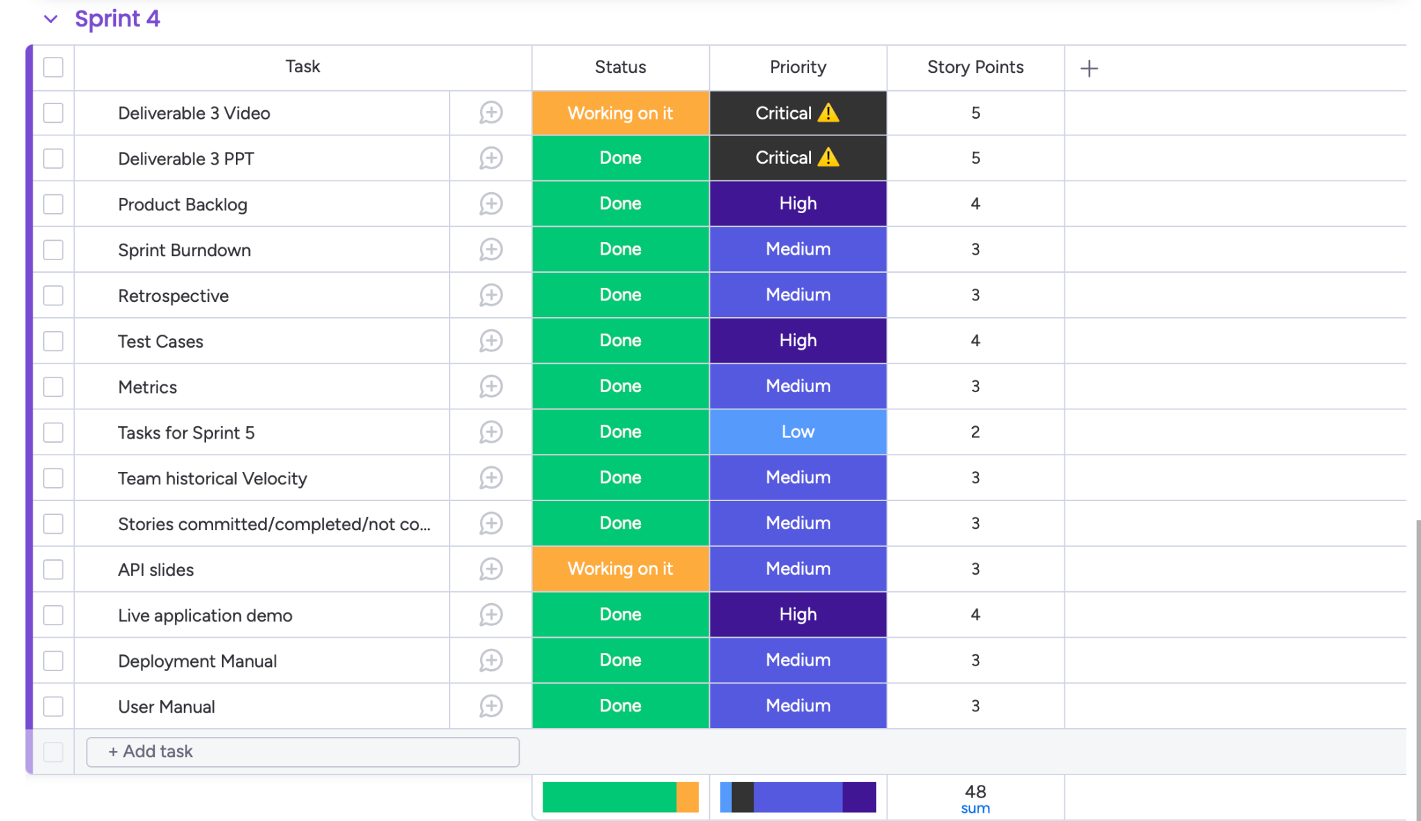
SPRINT 4 BURNDOWN CHART

Slide 51
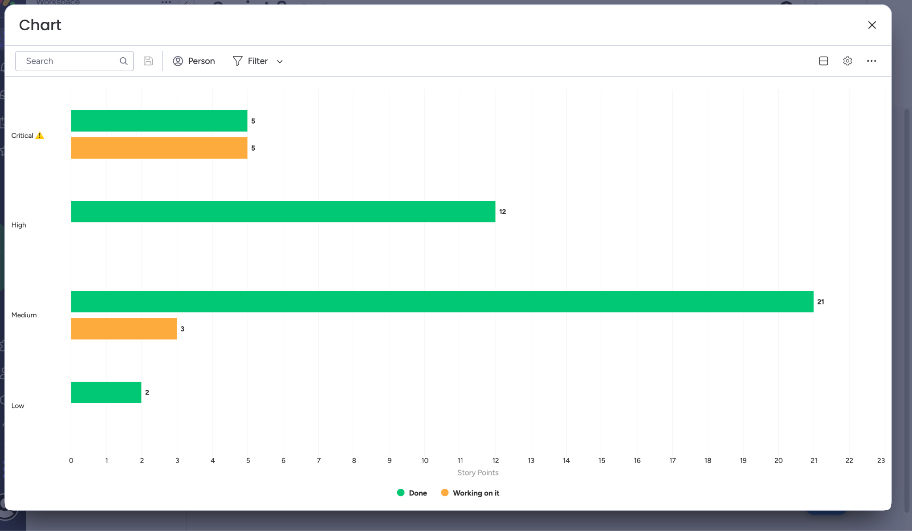
Sprint 4 Velocity

Slide 52
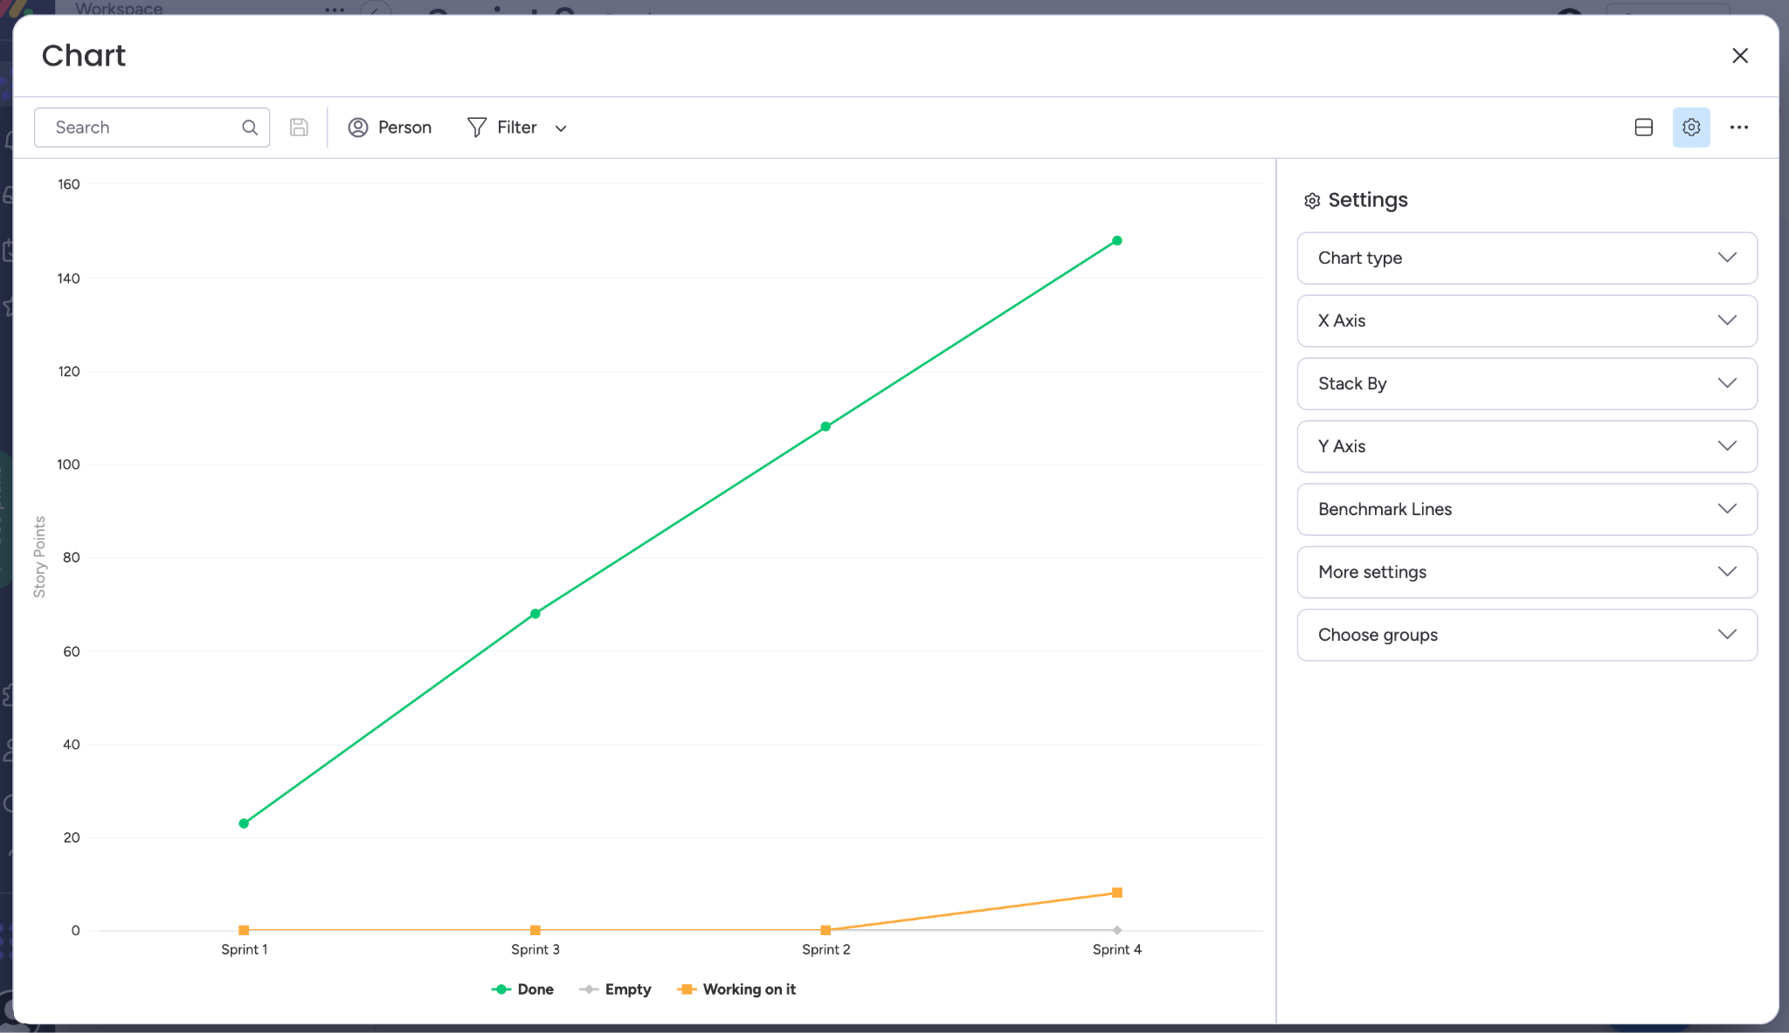
TEAM HISTORY VELOCITY

Slide 53
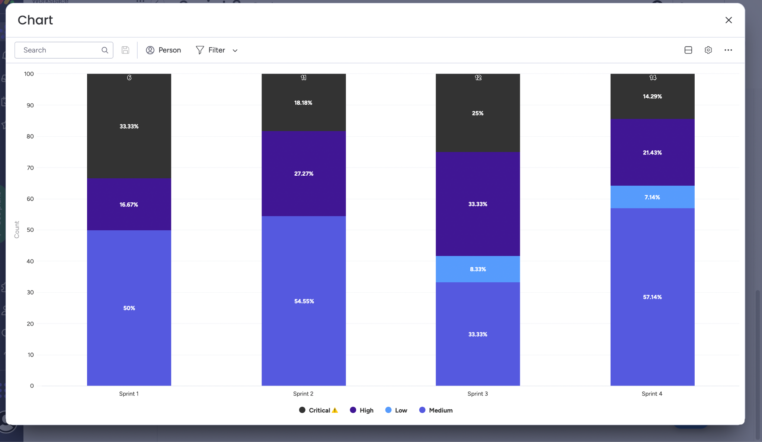
TEAM Ratio

Slide 54
10
RETROSPECTIVE

Slide 55
RETROSPECTIVE
WHAT WENT WELL
WHAT NEED TO IMPROVE
NEXT STEPS
- Completed our work on time
- The Languru app at this sprint was implemented by more functions.
We need to enhance the interface of the application to give it a more appealing and visually pleasing appearance.
The team will try to add more features and functions to Languru app.

Slide 56
11
SPRINT 5

Slide 57
Stories planned and committed for Sprint 5
Issue Type | Key | Name | Status | Story Point Estimate
Story |  | As an user, I want to keep track of my progress in pronunciation and fluency So that I can see my improvement over time. | To do | 3
Story |  | As an user, I want to practice with longer sentences. | To do | 5

Slide 58
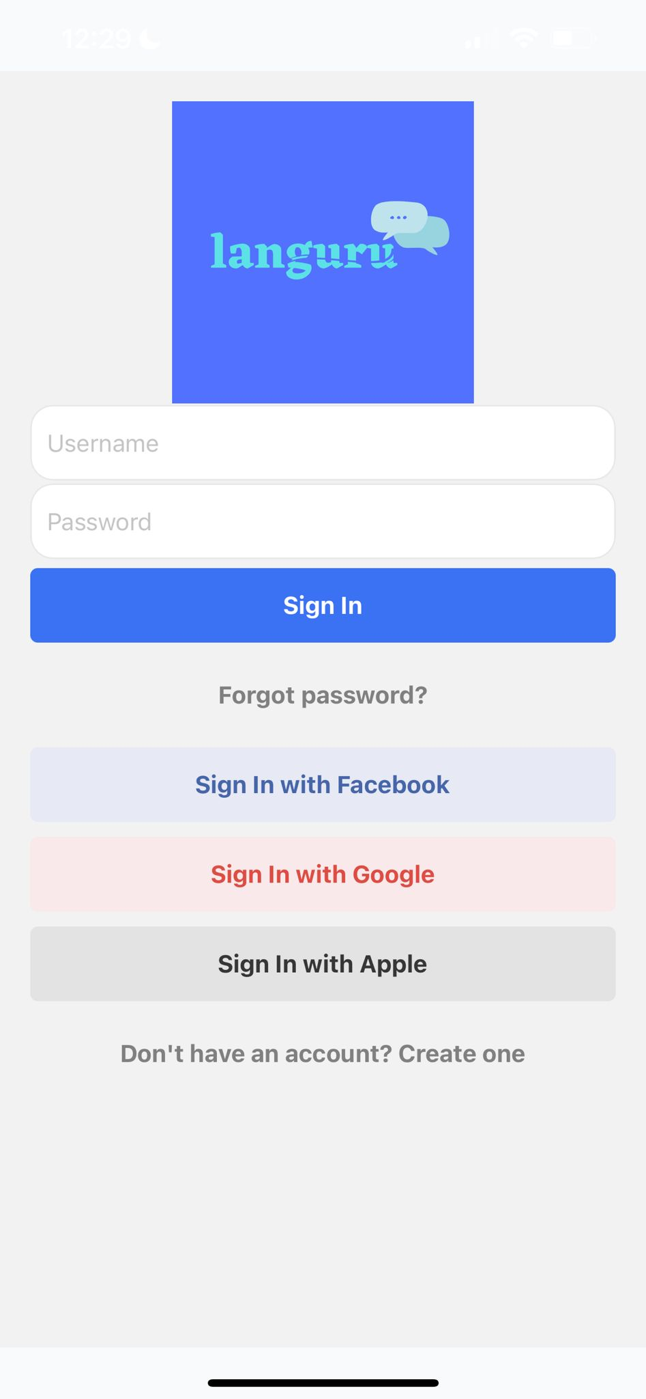
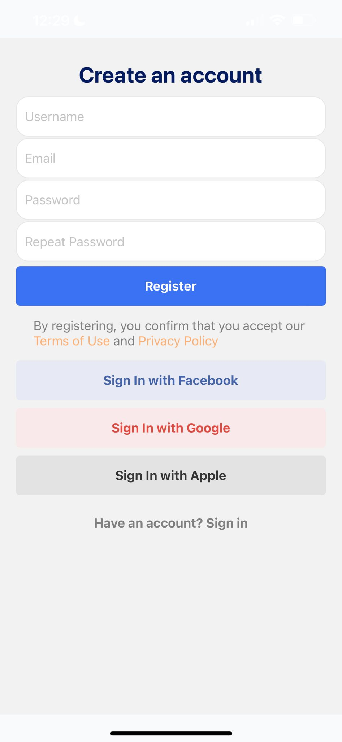
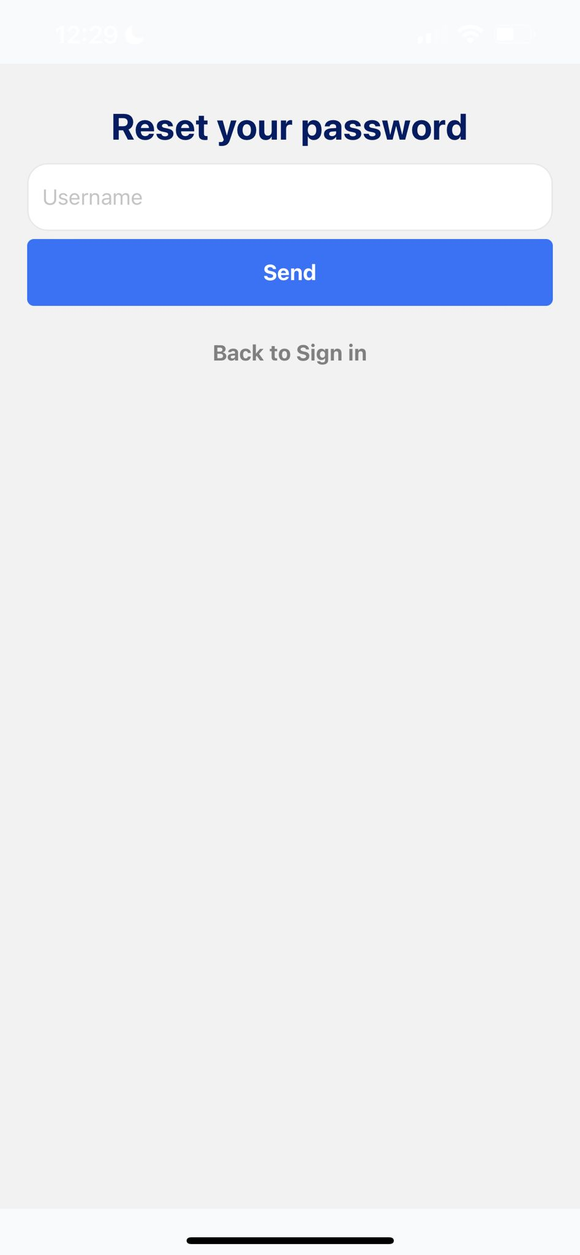
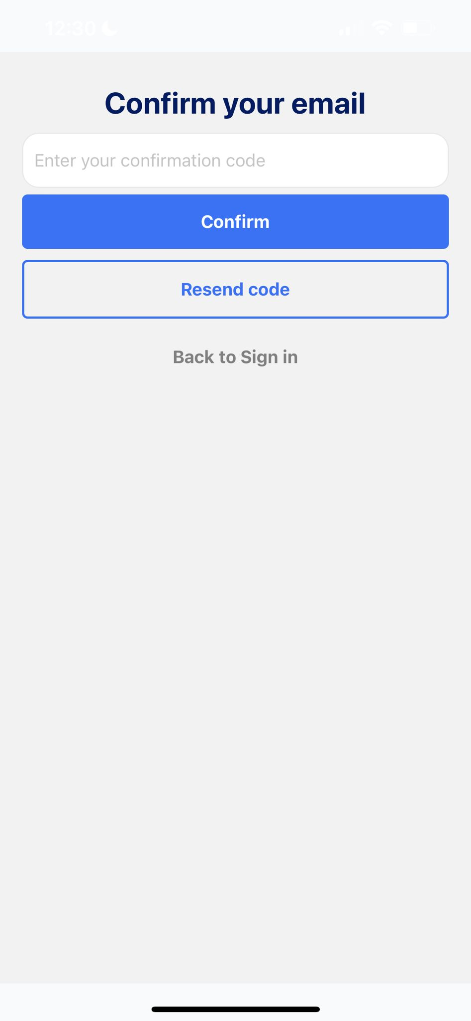
LANGURU APP SCREENSHOTS
Sign in page
Sign up page
Forgot password
After register

Slide 59
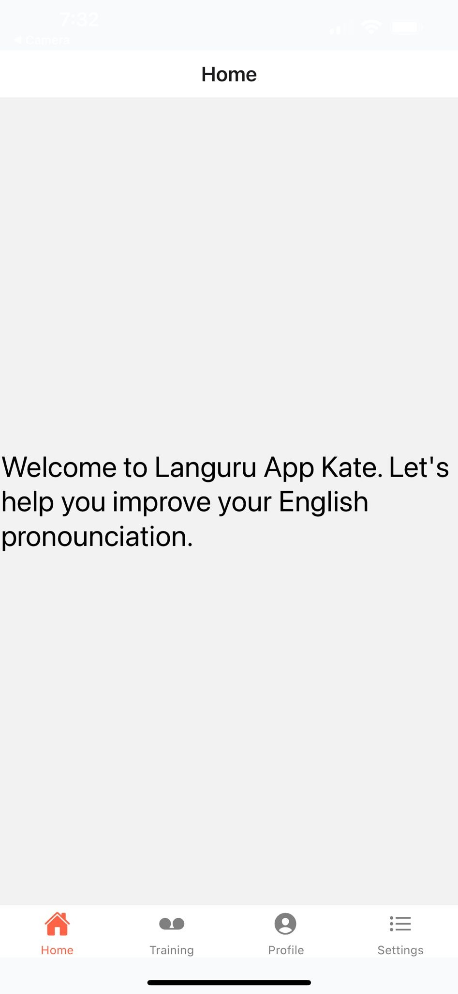
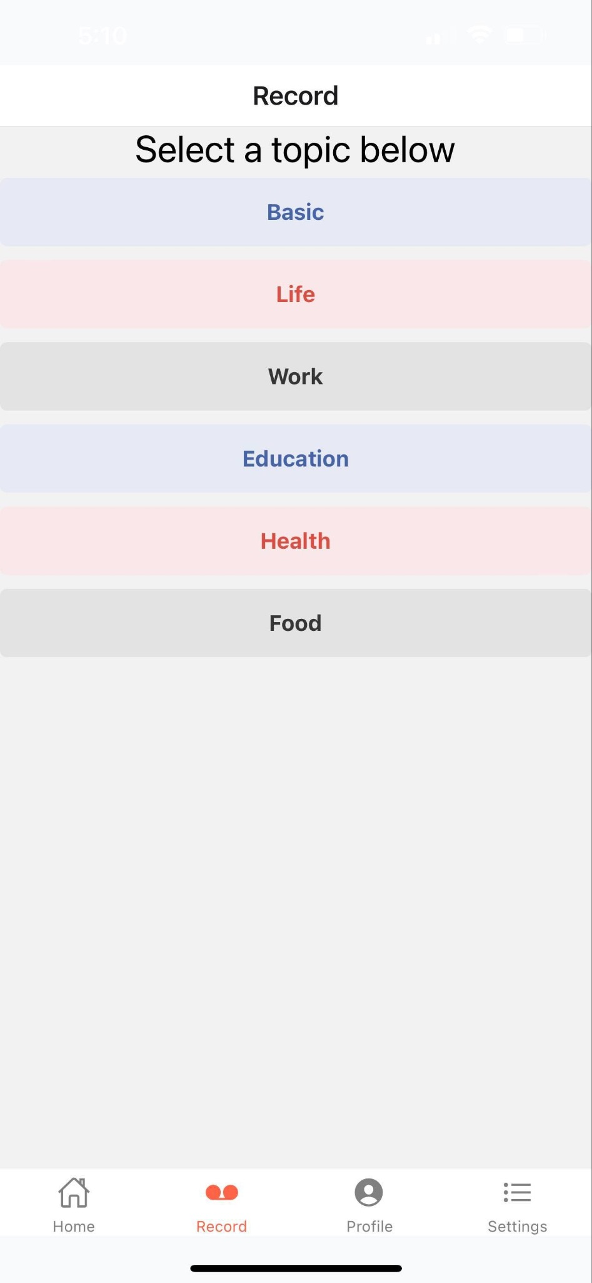
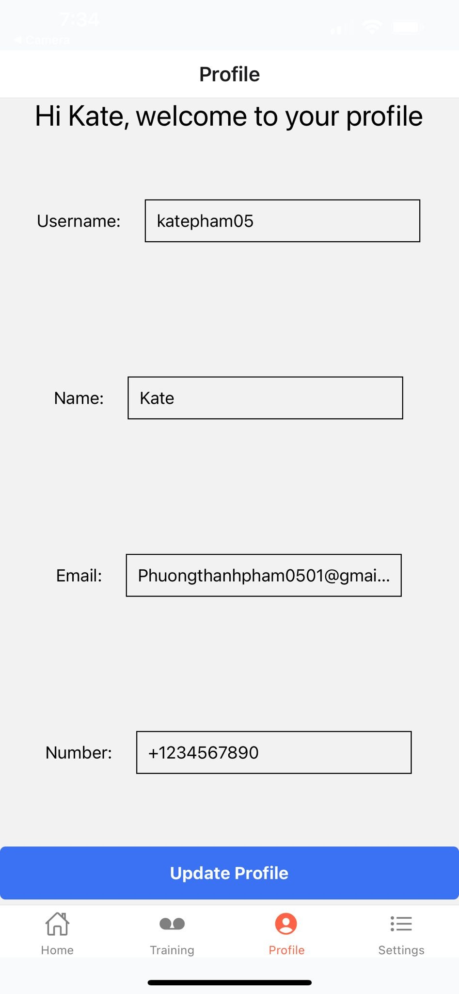
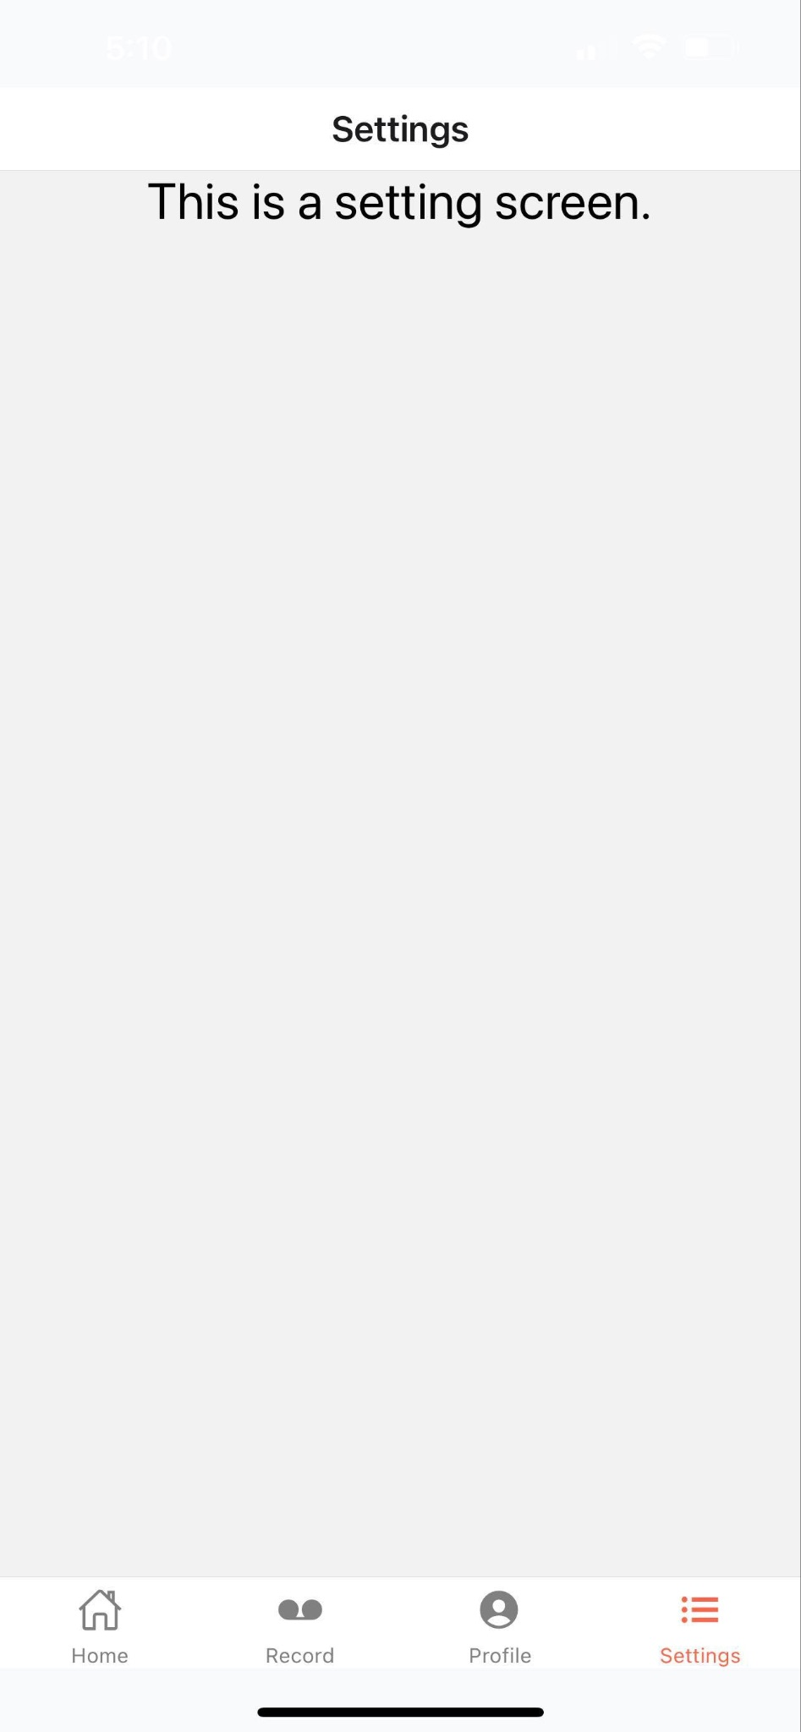
LANGURU APP SCREENSHOTS
Home page
Training page
Profile Page
Setting Page

Slide 60
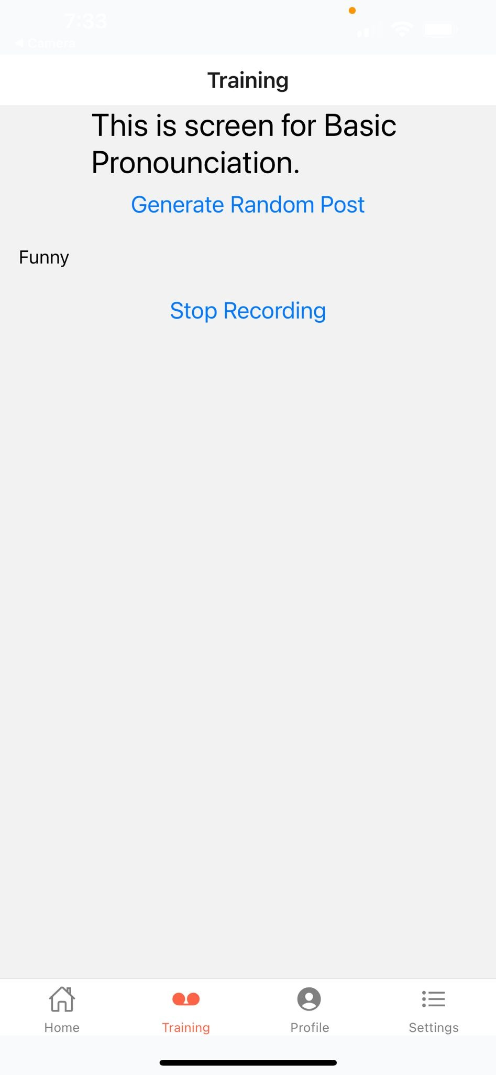
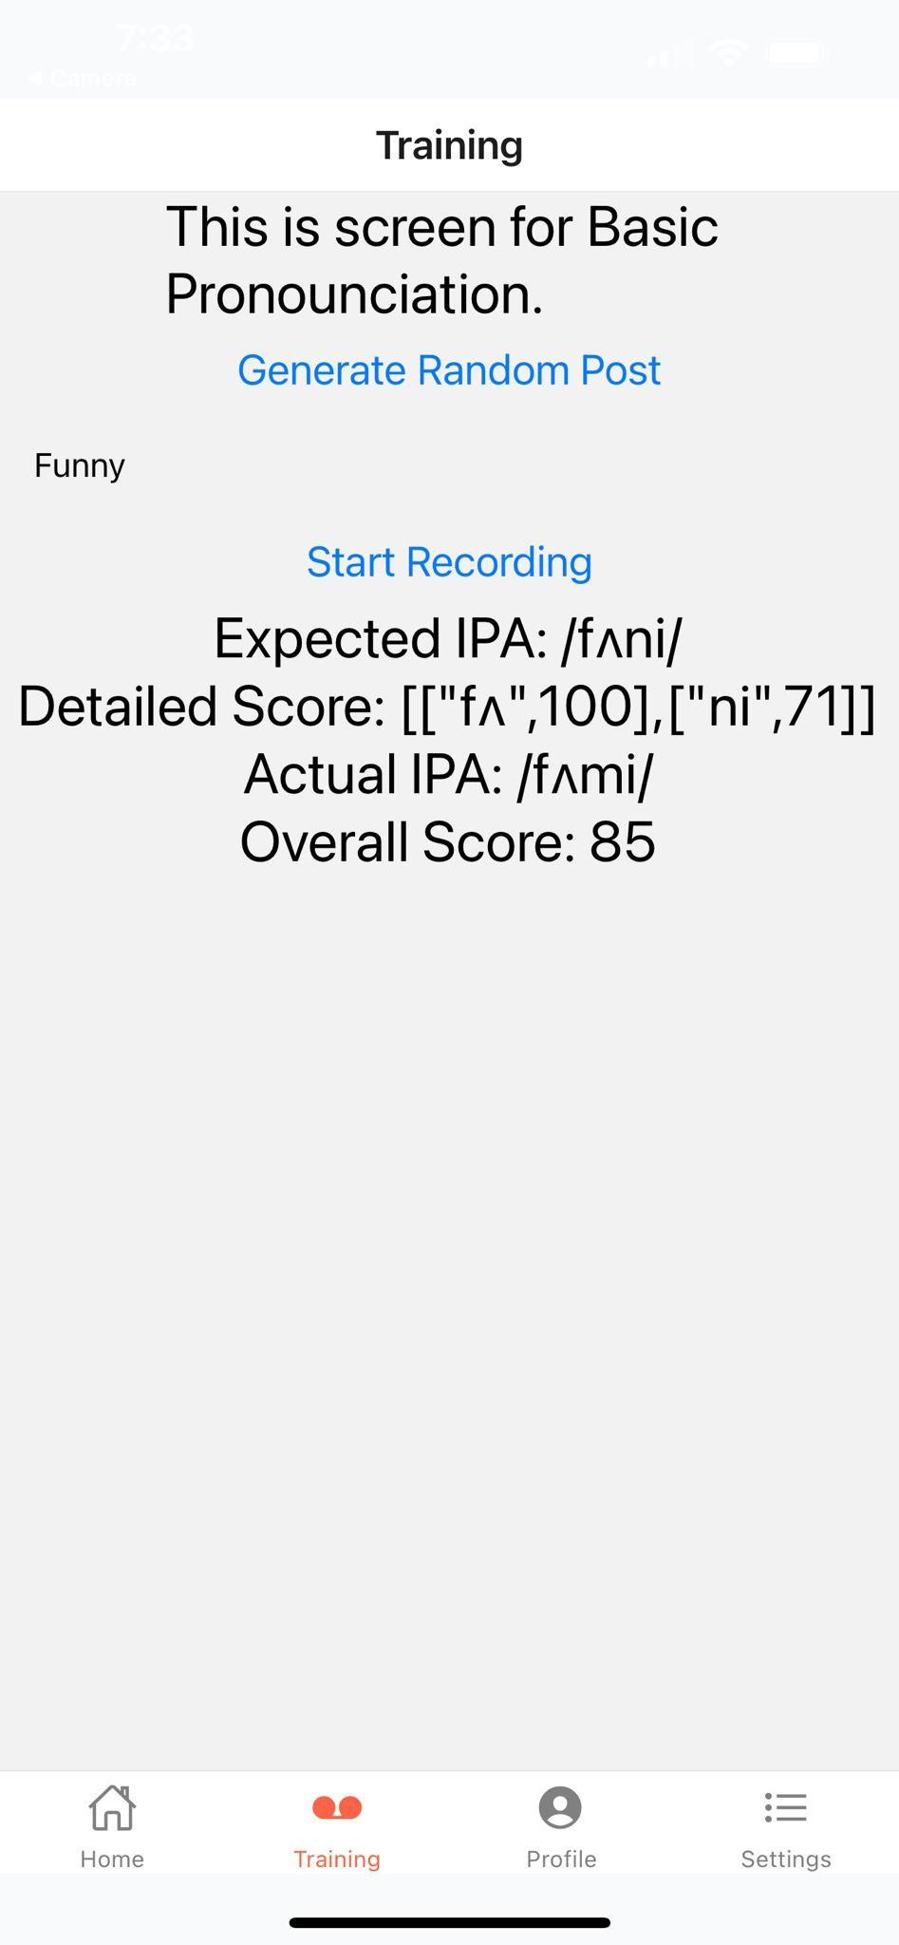
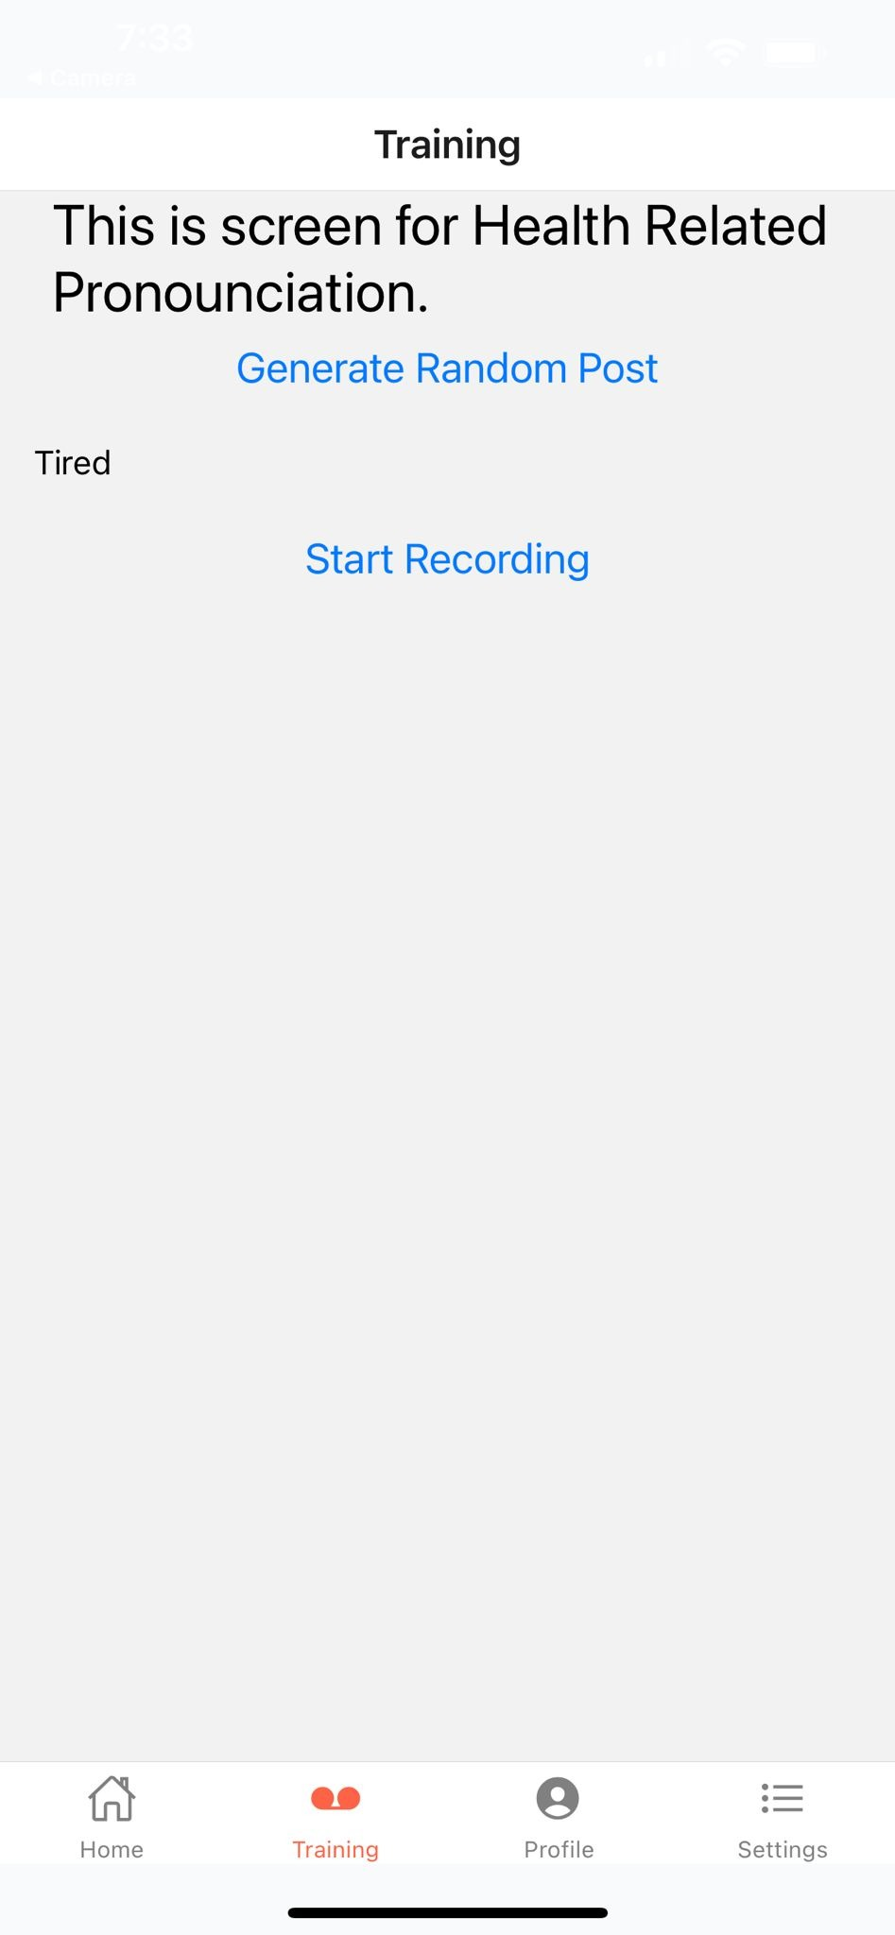
LANGURU APP SCREENSHOTS
Basic Screen
Scored in Basic screen
Health Page

Slide 61
LIVE APPLICATION DEMO

Slide 62
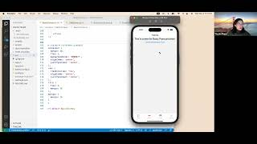

Slide 63


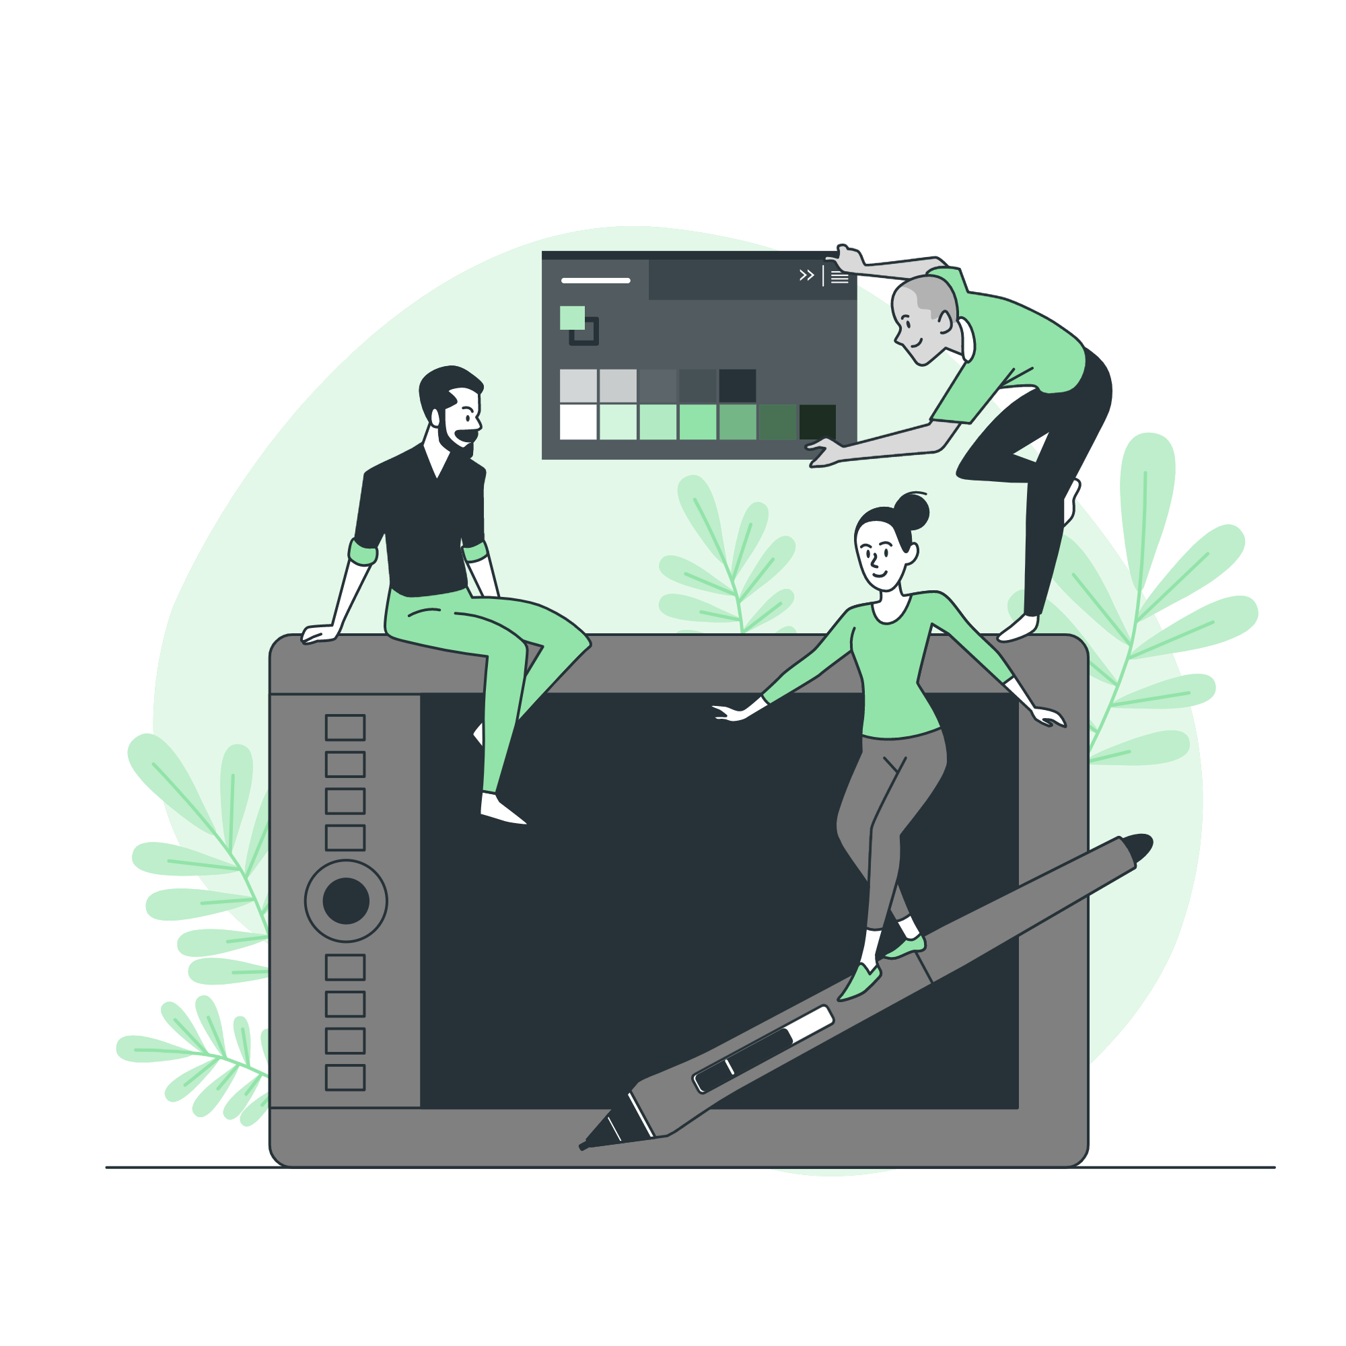

Project links
Github Link
User manual link
User manual link
User manual link
User manual link
User manual link
Technical paper link
Deployment manual link
https://github.com/htmw/Languru/wikii
Technical paper link
Deployment Manual Link
User Manual Link

Slide 64
—TEAM 5 RADIANT
THANK YOU!

